Slide 1
What’s New In Zillow’s Android Apps
Steve Perrin, Development Manager
Steven Kwan, Sr. Software Development Engineer
Sumiran Pradhan, Software Development Engineer

Slide 2
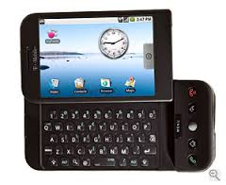
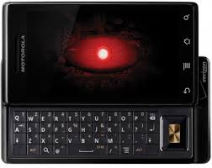
Background
Zillow’s Android Real Estate app is 5 Years Old! -– We released version 1.0 of the app in March 2010
Nearly 2/3 Zillow’s usage is on a mobile device; more than 70% on weekends
In June, 500M homes were viewed on Zillow mobile web/apps (218 homes/second)
Android is more than just phones now: tablets, Google Glass, watches, TV, auto

Slide 3
Overview
Android 5.0 “Lollipop” – Material Design UI updates
Android Wear – Bridged notifications and watch app
App Indexing – Link into your app from Google Search results
Google Now Cards – Surfacing your content in Google Now!
Multidex – Beyond the 64K method limit
WebView Templates – Updating your app without a Google Play release
Staged Rollout – Google Play incremental rollout
Android “M” Preview – Updated permission model

Slide 4
Android Lollipop
Sumiran Pradhan

Slide 5
Theming & Styling
Our application theme extends Theme.AppCompat.Light.NoActionBar
<item name="colorAccent">Zillow Blue color</item>
<item name="colorPrimary">@color/white</item>
<item name="colorPrimaryDark">Zillow Blue color</item>
Transparent Status Bar
window.setFlags( WindowManager.LayoutParams.FLAG_TRANSLUCENT_STATUS, WindowManager.LayoutParams.FLAG_TRANSLUCENT_STATUS );
Status Bar Height
int resourceId = context.getResources().getIdentifier("status_bar_height", "dimen", "android");
height = context.getResources().getDimensionPixelSize(resourceId);

Slide 6
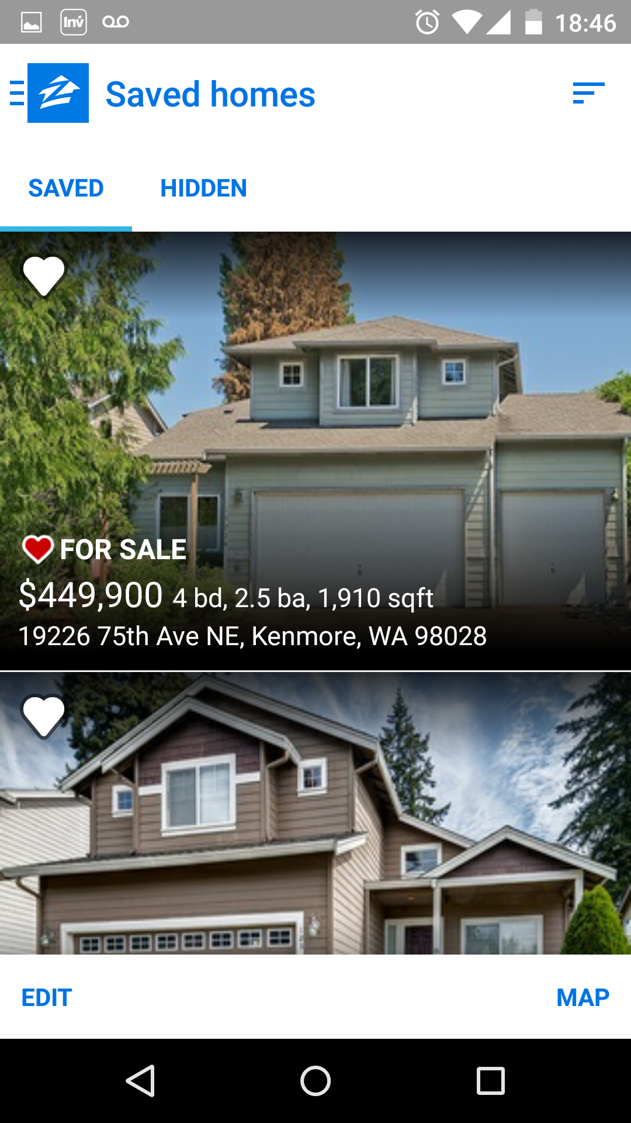
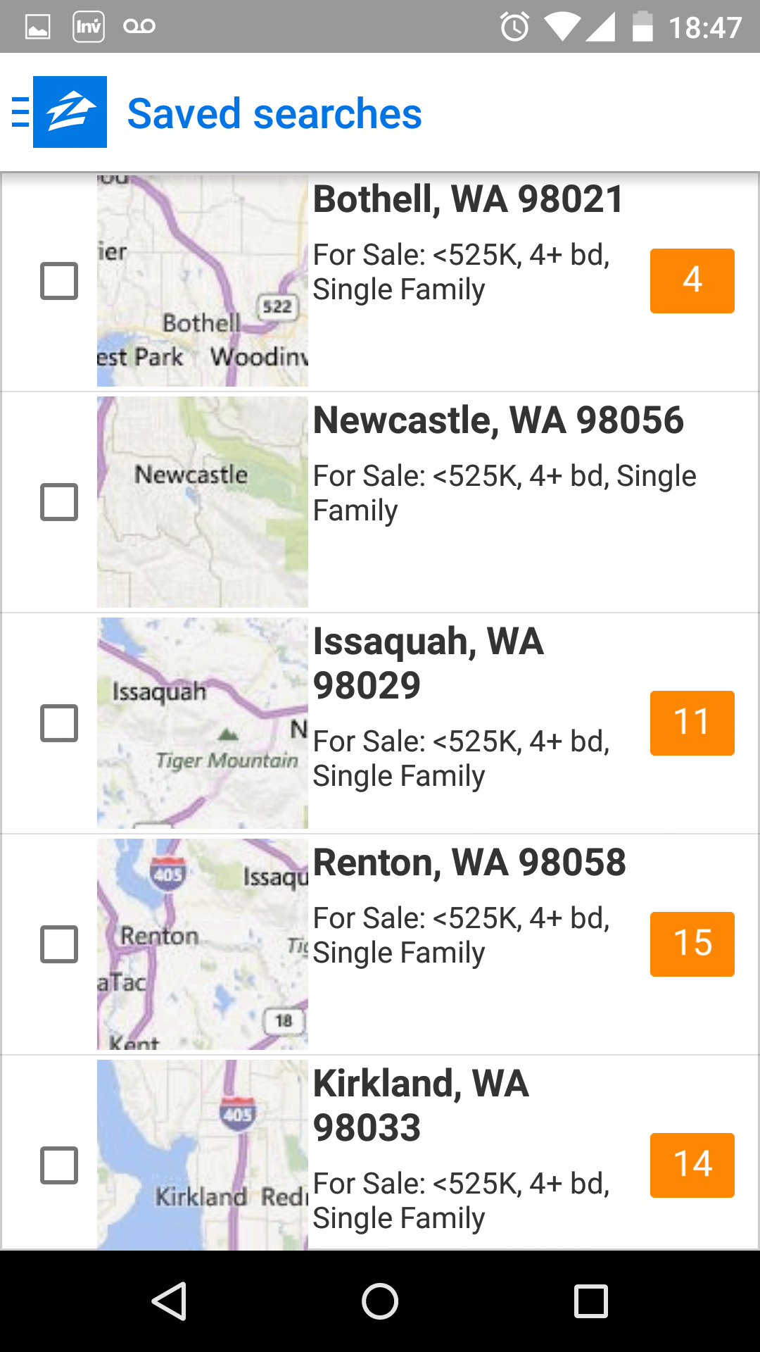
Toolbar
All our Action bars are Toolbars and in turn we extend AppCompatActivity
Embeds a toolbar as an action bar here which isolates the toolbar handling.
Toolbar has the Zillow branding on the ActionBarToggle

Slide 7
Home Detail Page styling
Home Detail Fragment owns the toolbar as the action bar
Background / Alpha drawable
toolbar.setBackground Vs toolbar.setBackgroundDrawable
Toolbar setTitleTextColor()
Overflow menu item R.string.abc_action_menu_overflow_description
decorView.findViewsWithText( viewsWithText, overflowDescription, View.FIND_VIEWS_WITH_CONTENT_DESCRIPTION )
Options Menu item
onPrepareOptionsMenu
changes color/drawable/tint based on current scroll position
supportInvalidateOptionsMenu

Slide 8
Miscellaneous Problems
Proguard
-keep,allowobfuscation class !android.support.v7.internal.view.menu.**, android.support.v7.** { *; }
ViewCompat.setElevation() does not do anything for pre Lollipop devices
Best place to look for theming is Android’s own values.xml: Theme.Appcompat.**
Debugging elevation problems
start with fixed sizes
To get the ripple effect through style
<style name=”Button" parent="Widget.AppCompat.Light.ActionButton">

Slide 9
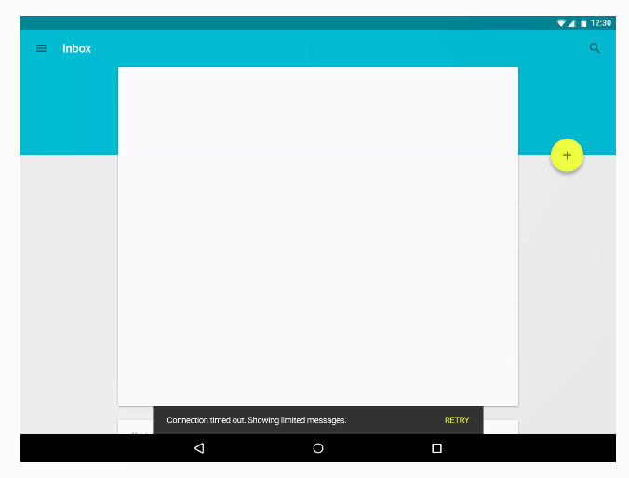
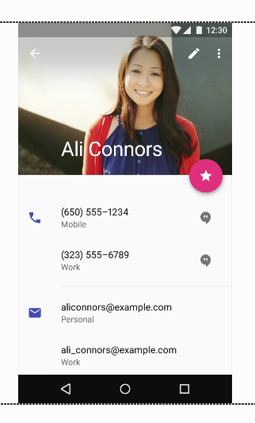
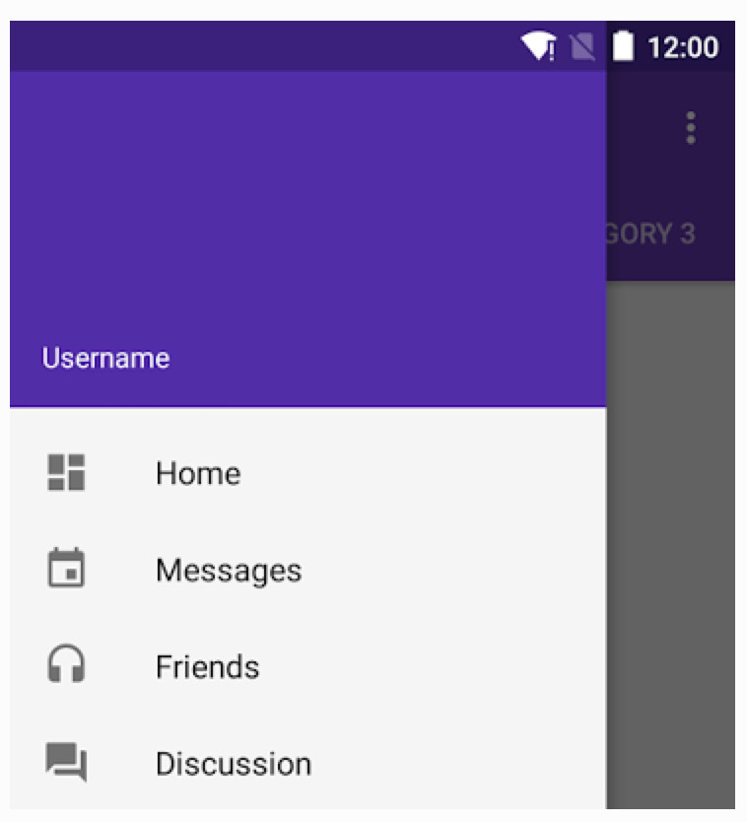
Design Support Library (Not integrated yet)
NavigationView – for navigation drawer elements
SnackBar – undo actions in the app
CoordinatorLayout / Collapsing Toolbar – might try to use this for our Home Detail Page layout

Slide 10
Android Wear
Steven Kwan

Slide 11
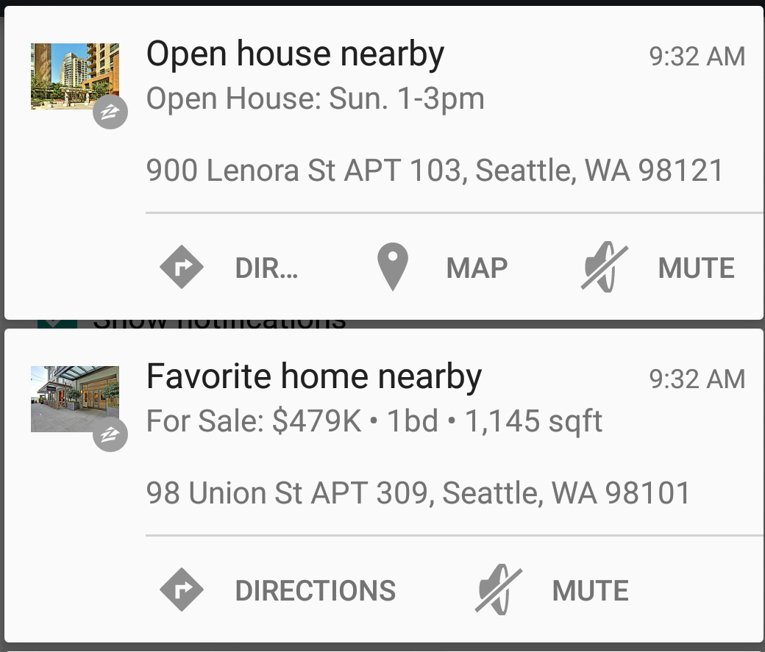
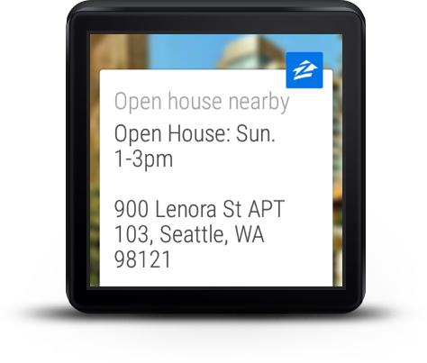
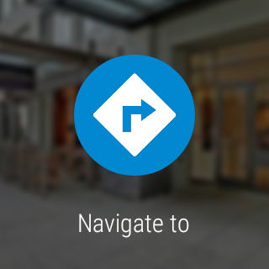
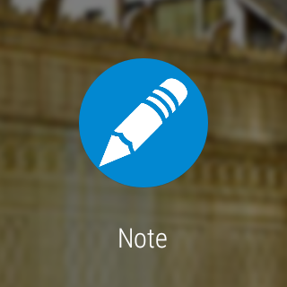
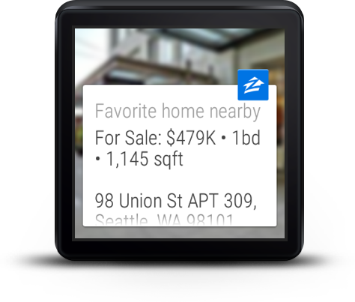
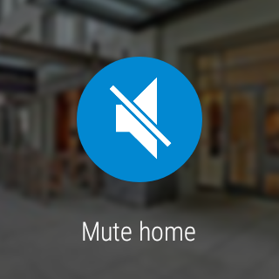
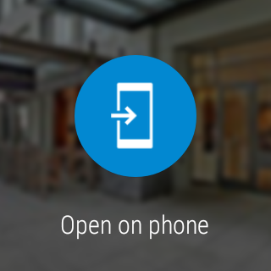
Wear of the Past
Bridged Notifications
Old notifications were easy to extend to the Wearable through a few lines of code.

Slide 12
Code for Bridge Notifications
import android.support.v4.app.NotificationCompat.WearableExtender;
...
private WearableExtender mWearableExtender;
...
mWearableExtender = new NotificationCompat.WearableExtender();
...
// Pending intent to mute home from notifications
PendingIntent muteHomePendingIntent = ...;
Action muteAction = new Action( wearDrawable, muteText, muteHomePendingIntent );
mNotificationBuilder.addAction( handheldDrawable, muteText, muteHomePendingIntent );
mWearableExtender.addAction( muteAction );
...
mNotificationBuilder.extend( mWearableExtender );

Slide 13
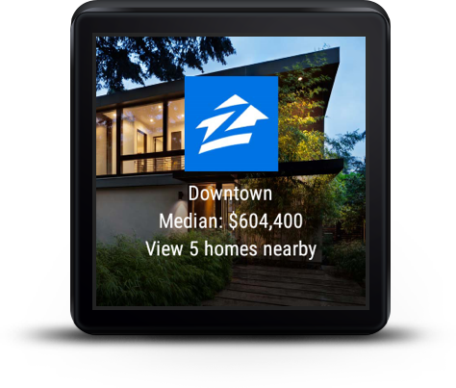
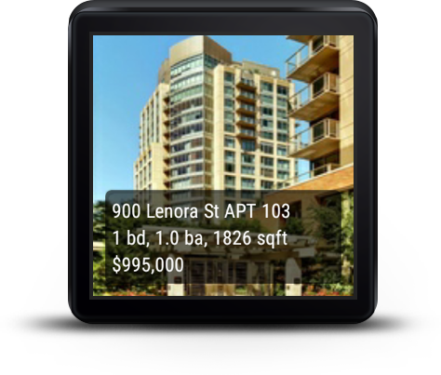
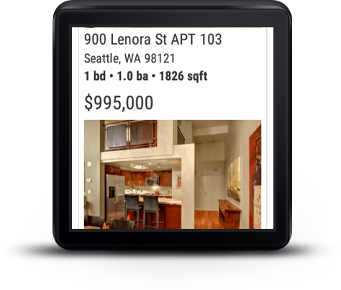
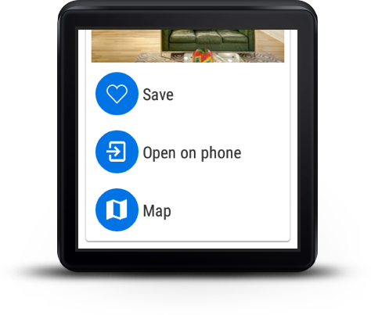
Goal of Our Wear App
Let users know the median home price of an area
Surface nearby homes matching their last search (i.e. for sale, for rent, …)
Display enough information about a home to the user so that they are able to decide if they want to save, map, or open up the full details page on their handheld.
Allow us to allow more rich notifications than what we got from Bridged Notifications

Slide 14
Building Basics
Terminology:
Phones & Tablets → Handheld
Watches → Wear/Wearables
Need a companion handheld app in order to ship in the play store
Wear app is pushed to a Wearable via the bundled APK that they download from the Play Store.
Requires:
SDK tools v23+
SDK Android 4.4W.2+
Latest Google Play services
Android Wearable or Emulator
Have the handheld do as much heavy lifting as you can for you
Network I/O
Data/Image processing
Getting GPS location
Figure out contexts of when we can alert on the watch

Slide 15
Communication Model
MessageApi
Small payloads, typically strings
DataApi
Large payloads like images, or objects
WearableListenerService
Background service that listens for messages or data changes from other devices (nodes)
DataListener
Foreground equivalent of the callbacks found in WearableListenerService

Slide 16
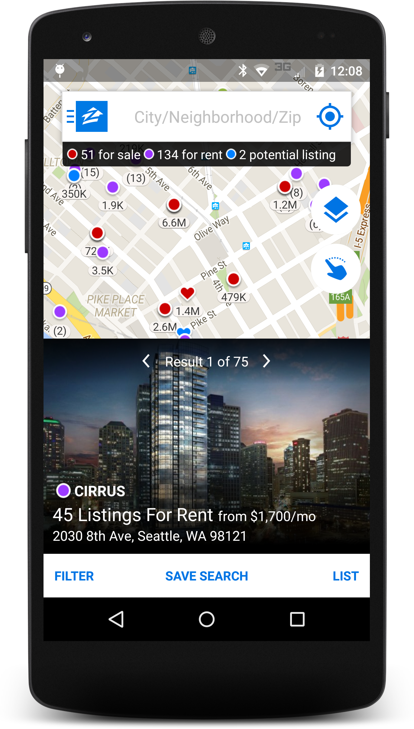
What we have
HandheldToWearIntentService
Background service that we pass our desired data from the handheld to send to the wear
WearToHandheldIntentService
Background service that we pass our desired data from the Wear to send to the handheld
HandheldListenerService
Background listener service that receives messages or data API events from the wearable
WearListenerService
Background listener service that receives messages or data API events from the handheld
HandheldToWearIntentService
WearListenerService
HandheldListenerService
WearToHandheldIntentService

Slide 17
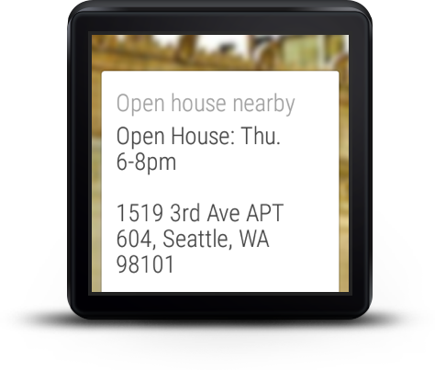
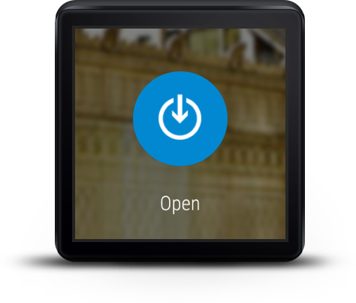
Rich Bridged Notifications
We can customize the details to a notification on a wearable more by providing a payload of details from the Handheld app to the Wear app over our communication model.
We can have a notification open into the wear app and provide them an experience on their Wearable if the information doesn’t require their Handheld.
We can add analytics to notifications interaction on the Wear device.

Slide 18
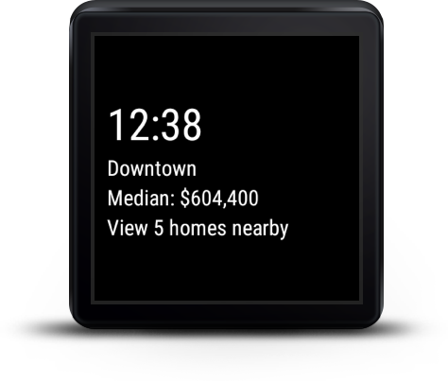
Ambient Mode
Keep your app visible, but preserve battery power.
You can set up whatever data you want to display
Our V1, we display the neighborhood summary in case you leave the app on and move into another neighborhood.
Activities where you want to do some sort of low power display or messaging need to extend WearableActivity
Implement:
public void onEnterAmbient( Bundle ambientDetails ) public void onUpdateAmbient() public void onExitAmbient()

Slide 19
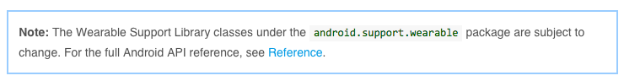
Gotchas & Tips
Documents are always changing, as well as their API.
CardFragment isn’t actually scrollable. We had to use a GridViewPager and have a FragmentGridPagerAdapter provide the CardFragment in order to get the card to scroll. .
BoxInsetLayout doesn’t work unless you use Theme.DeviceDefault
The Wear App must inherit from Theme.DeviceDefault in order to distinguish between the round and square devices. This includes the WatchViewStub, but also some default sizing/styling that happens for things like CardFragments and CardViews.
FreezableUtils.freezeIterable ( dataEvents );
If using an emulator, just make an alias for adb -d forward tcp:5601 tcp:5601
F7 puts an Wearable Emulator into Ambient Mode

Slide 20
More…
Steve Perrin

Slide 21
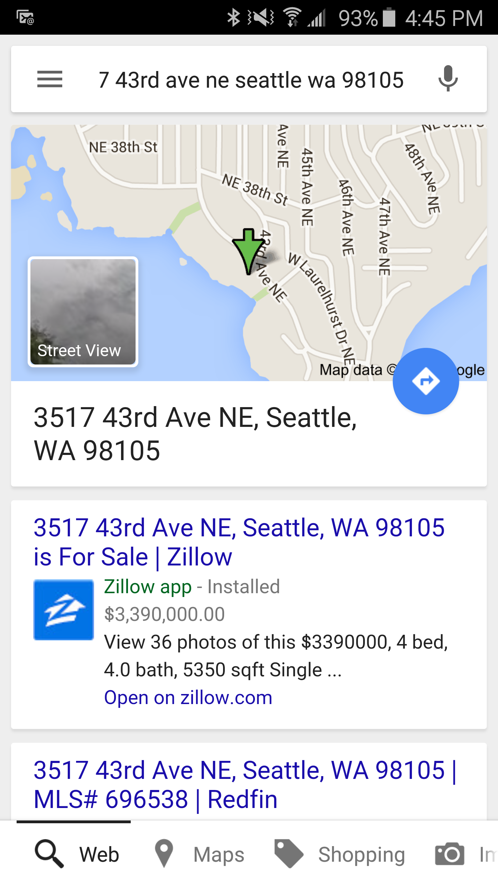
App Indexing
Making your app content available in Google Search results
App support for deep links to search results and detail pages
Alt links on corresponding desktop/mobile web pages
Google Mobile Bot indexes app links and shows button to install/open app
<link rel="alternate" href="android-app://com.zillow.android.zillowmap/http/www.zillow.com/homedetails/3517-43rd-Ave-NE-Seattle-WA-98105/48928897_zpid"></link>

Slide 22
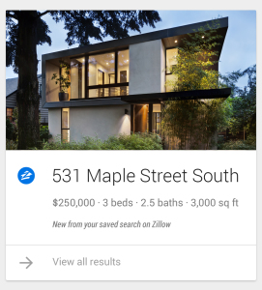
Google Now Cards
Surfacing your app’s content in Google Now
Users receive new listings and updates to homes based on their saved searches and favorites
Click on the Google Now card to open full home details in Zillow Android app
When user logs into app, get a Google Now token
Zillow server pushes cards to Google on new/updated homes match users searches or favorites.

Slide 23
Multidex
Dalvik Executable (DEX) 64K method limit
Avoiding use of large libraries
Using ProGuard to remove unreferenced methods
Android 5.0 uses ART runtime with native multidex
Android 4.x still 40% of our users
Multidex support with Android SDK Build Tools 21.1
Enable multidex in build.gradle
Inherit from MultiDexApplication
dependencies {
compile "com.android.support:multidex:1.0.0”
}
android {
buildTypes {
all {
minifyEnabled true
multiDexEnabled true
proguardFiles getDefaultProguardFile('proguard-android.txt'), 'proguard-project.txt'
}
}
}

Slide 24
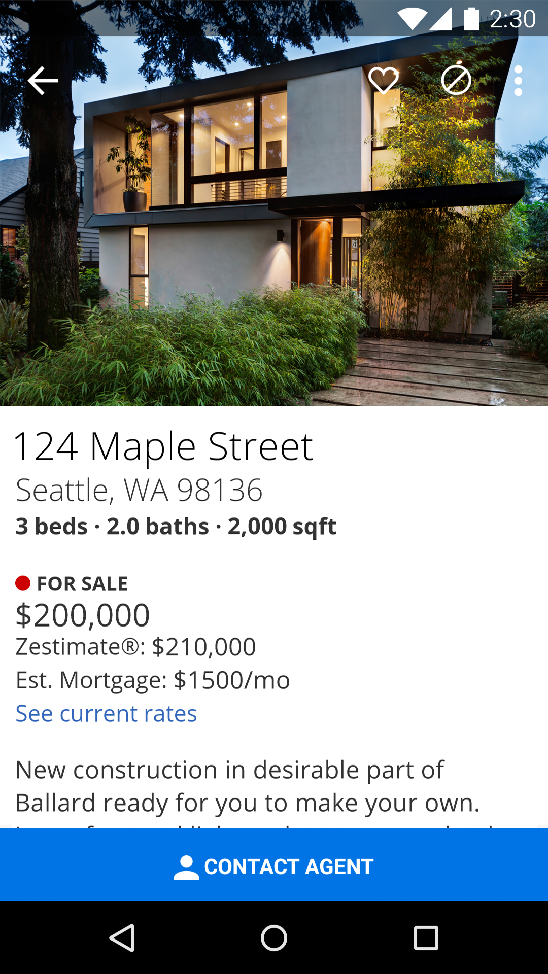
WebView Templates
Updating your app without releasing a new APK
Zillow Home Details Page (HDP) has frequent updates
Front-end developers HTML/CSS/Javascript
Sharing between desktop, mobile web, mobile apps (Android and iOS)
Native/WebView hybrid approach
Mustache template/resource approach

Slide 25
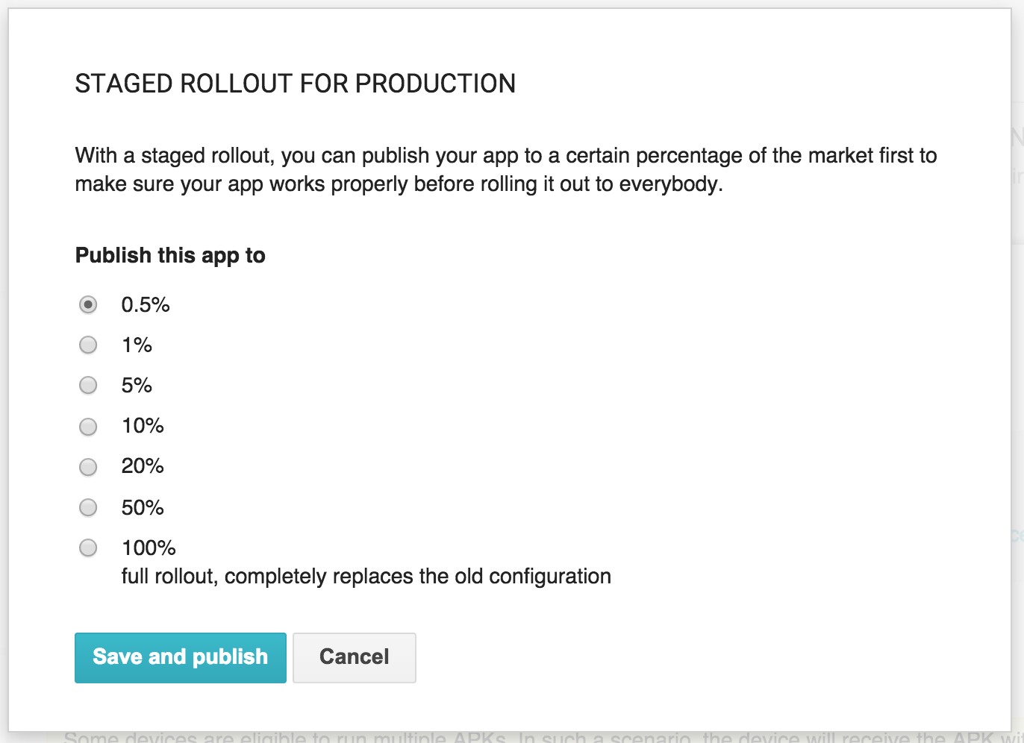
Staged Rollout
Google Play staged rollout to 5%
Check Crashlytics for any crash reports
Check reviews/ratings on Google Play
Fix any issues and increase rollout percentage

Slide 26
Android M
Biggest issue we’re going to face: PERMISSIONS
New Model
[Apps targeting Android M asked at the time they will use a permission if they have access]
Apps targeting older versions of Android will still have the install time request of permissions
This means we need to update :
the UX to ask for permissions
the UX to handle denial
the UX to explain why we need a permission
the UI to reflect immediately the use of the permission
Worth noting: even if you don’t target Android M, users on M can reject permissions from the device’s settings screen for the app and that will lead to a Permissions exception.

Slide 27
Questions?
Steve Perrin stevep@zillow.com
Steven Kwan stevenk@zillow.com
Sumiran Pradhan sumiranp@zillow.com

Slide 28
Thank You!
Steve Perrin stevep@zillow.com
Steven Kwan stevenk@zillow.com
Sumiran Pradhan sumiranp@zillow.com

